Slide 1
Data Link Layer
Computer Networking: A Top Down Approach Featuring the Internet,
3rd edition.
Jim Kurose, Keith Ross
Addison-Wesley, July 2004.
5-<number>

Slide 2
Link Layer
Introduction and services
Error detection and correction
Multiple access protocols
Link-Layer Addressing
Ethernet
Hubs and switches
5: DataLink Layer
5-<number>

Slide 3





Link Layer: Introduction
“link”
Some terminology:
hosts and routers are nodes
communication channels that connect adjacent nodes along communication path are links
  wired links
  wireless links
  LANs
layer-2 packet is a frame, encapsulates datagram
data-link layer has responsibility of
transferring datagram from one node
to adjacent node over a link
5: DataLink Layer
5-<number>

Slide 4
Link Layer Services
Framing, link access:
  encapsulate datagram into frame, adding header, trailer
  channel access if shared medium
  “MAC” addresses used in frame headers to identify source, dest
    different from IP address!
Reliable delivery between adjacent nodes
  we learned how to do this already
  seldom used on low bit error link (fiber, some twisted pair)
  wireless links: high error rates
    Q: why both link-level and end-end reliability?
5: DataLink Layer
5-<number>

Slide 5
Link Layer Services (more)
Flow Control:
  pacing between adjacent sending and receiving nodes
Error Detection:
  errors caused by signal attenuation, noise.
  receiver detects presence of errors:
    signals sender for retransmission or drops frame
Error Correction:
  receiver identifies and corrects bit error(s) without resorting to retransmission
Half-duplex and full-duplex
  with half duplex, nodes at both ends of link can transmit, but not at same time
5: DataLink Layer
5-<number>

Slide 6
Adaptors Communicating
datagram
link layer protocol
rcving
node
sending
node
frame
frame
adapter
adapter
link layer implemented in “adaptor” (NIC)
  Ethernet card, PCMCI card, 802.11 card
sending side:
  encapsulates datagram in a frame
  adds error checking bits, rdt, flow control, etc.
receiving side
  looks for errors, rdt, flow control, etc
  extracts datagram, passes to rcving node
link & physical layers
5: DataLink Layer
5-<number>

Slide 7
Link Layer
Introduction and services
Error detection and correction
Multiple access protocols
Link-Layer Addressing
Ethernet
Hubs and switches
PPP
Link Virtualization: ATM
5: DataLink Layer
5-<number>

Slide 8

Error Detection
EDC= Error Detection and Correction bits (redundancy)
D = Data protected by error checking, may include header fields
Error detection not 100% reliable!
  protocol may miss some errors, but rarely
  larger EDC field yields better detection and correction
5: DataLink Layer
5-<number>

Slide 9
Error Detection Schemes
Parity Bit
Internet Checksum
CRC
5: DataLink Layer
5-<number>

Slide 10
Parity
Value of parity bit is such that character has even (even parity) or odd (odd parity) number of ones
Simple Parity
Longitudinal Redundancy Check/Vertical Redundancy Check (LRC/VRC)

Slide 11
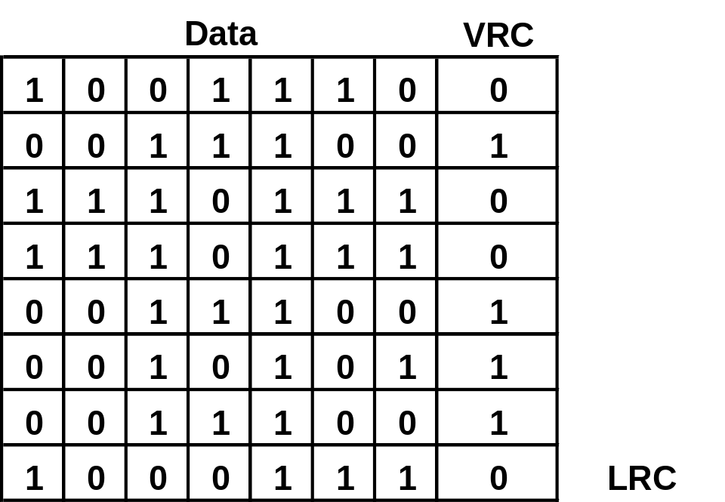
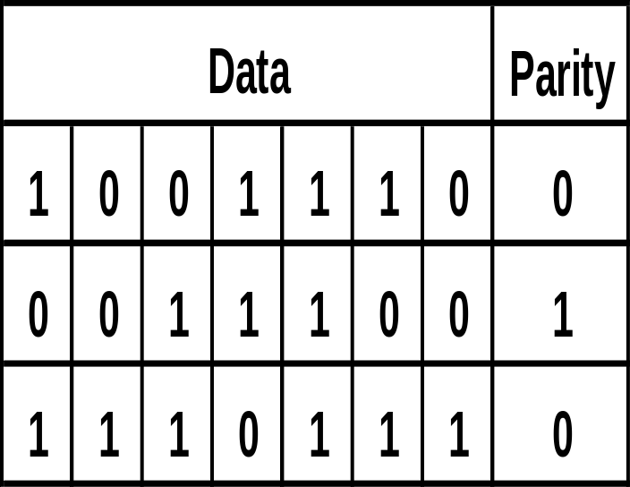
Parity Examples - Using Even Parity
Even Parity of 1’s
LRC/VRC

Slide 12
Parity Checks
Simple parity - If performing even parity, add a parity bit such that an even number of 1s are maintained.
If performing odd parity, add a parity bit such that an odd number of 1s are maintained.
For example, if the character 1001010 is to be sent, using even parity, a parity bit = 1 would be added to the character.
If the character 1001011 is to be sent, using even parity, a parity bit = 0 would be added to the character.

Slide 13
Parity Checks
What happens if the character 10010101 (parity bit is the last bit) and the first two 0s accidentally become two 1s?
Thus, the following character is received: 11110101.
Will there be a parity error?
High overhead (one extra bit per 7-bit character=12.5%)
Problem: Simple parity only detect bits in error (50%)

Slide 14
Parity Checks
Longitudinal parity adds a parity bit to each character then adds a row of parity bits after a block of characters.
The row of parity bits is actually a parity bit for each “column” of characters.
The row parity bits plus the column parity bits add a great amount of redundancy to a block of characters.

Slide 15
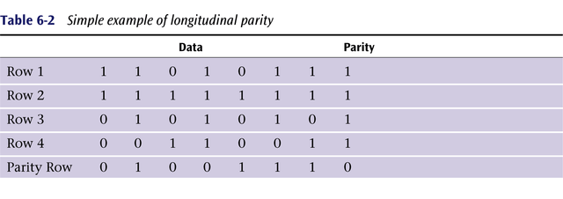
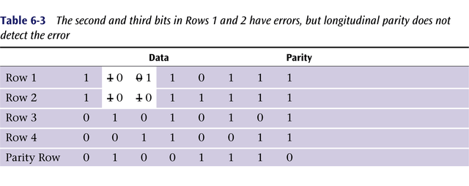

Slide 16

Checksumming: Cyclic Redundancy Check
view data bits, D, as a binary number
choose r+1 bit pattern (generator), G
goal: choose r CRC bits, R, such that
  <D,R> exactly divisible by G (modulo 2)
  receiver knows G, divides <D,R> by G. If non-zero remainder: error detected!
  can detect all burst errors less than r+1 bits
widely used in practice (Ethernet, 802.11 WiFi, ATM)
DataLink Layer

Slide 17

M = 1 0 1 1 1 0
G = 1 0 0 1
R(x) =
remainder of [2 ^{r} M(x)/G(x)]
Where r = 3
5: DataLink Layer
5-<number>

Slide 18
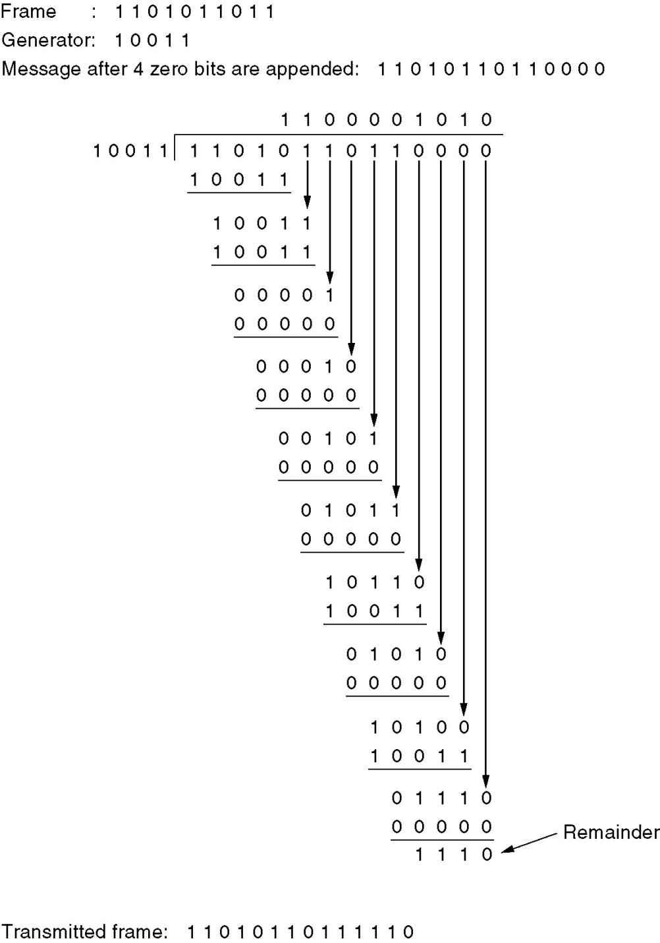
Error-Detecting Codes
Ref: Tannenbaum, Fig. 3-8

Slide 19
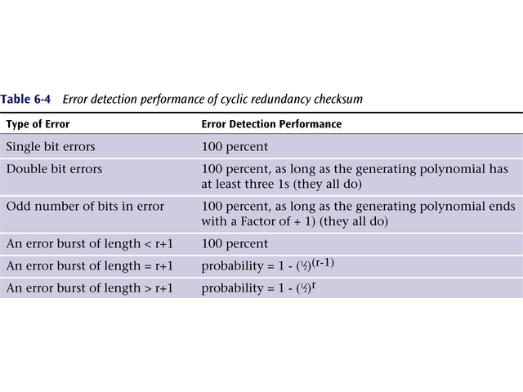
Data Communications and Computer Networks
Chapter 6
r is the degree of the generating polynomial

Slide 20
Link Layer
Introduction and services
Error detection and correction
Multiple access protocols
Link-Layer Addressing
5: DataLink Layer
5-<number>

Slide 21
Multiple Access protocols
single shared broadcast channel
two or more simultaneous transmissions by nodes: interference
  collision if node receives two or more signals at the same time
multiple access protocol
distributed algorithm that determines how nodes share channel, i.e., determine when node can transmit
communication about channel sharing must use channel itself!
  no out-of-band channel for coordination
5: DataLink Layer
5-<number>

Slide 22
MAC Protocols: a taxonomy
Three broad classes:
Channel Partitioning
  divide channel into smaller “pieces” (time slots, frequency, code)
  allocate piece to node for exclusive use
Random Access
  channel not divided, allow collisions
  “recover” from collisions
“Taking turns”
  Nodes take turns, but nodes with more to send can take longer turns
5: DataLink Layer
5-<number>

Slide 23

Channel Partitioning MAC protocols: TDMA
TDMA: time division multiple access
access to channel in "rounds"
each station gets fixed length slot (length = pkt trans time) in each round
unused slots go idle
example: 6-station LAN, 1,3,4 have pkt, slots 2,5,6 idle
TDM (Time Division Multiplexing): channel divided into N time slots, one per user; inefficient with low duty cycle users and at light load.
FDM (Frequency Division Multiplexing): frequency subdivided.
5: DataLink Layer
5-<number>

Slide 24
Channel Partitioning MAC protocols: FDMA
FDMA: frequency division multiple access
channel spectrum divided into frequency bands
each station assigned fixed frequency band
unused transmission time in frequency bands go idle
example: 6-station LAN, 1,3,4 have pkt, frequency bands 2,5,6 idle
TDM (Time Division Multiplexing): channel divided into N time slots, one per user; inefficient with low duty cycle users and at light load.
FDM (Frequency Division Multiplexing): frequency subdivided.
time
frequency bands
5: DataLink Layer
5-<number>

Slide 25
Random Access Protocols
When node has packet to send
  transmit at full channel data rate R.
  no a priori coordination among nodes
two or more transmitting nodes ➜ “collision”,
random access MAC protocol specifies:
  how to detect collisions
  how to recover from collisions (e.g., via delayed retransmissions)
Examples of random access MAC protocols:
  slotted ALOHA
  ALOHA
  CSMA, CSMA/CD, CSMA/CA
5: DataLink Layer
5-<number>

Slide 26

Pure (unslotted) ALOHA
unslotted Aloha: simpler, no synchronization
when frame first arrives
  transmit immediately
5: DataLink Layer
5-<number>

Slide 27
Slotted ALOHA
Assumptions
all frames same size
time is divided into equal size slots, time to transmit 1 frame
nodes start to transmit frames only at beginning of slots
nodes are synchronized
if 2 or more nodes transmit in slot, all nodes detect collision
Operation
when node obtains fresh frame, it transmits in next slot
no collision, node can send new frame in next slot
if collision, node retransmits frame in each subsequent slot with prob. p until success
5: DataLink Layer
5-<number>

Slide 28

Slotted ALOHA
Pros
single active node can continuously transmit at full rate of channel
highly decentralized: only slots in nodes need to be in sync
simple
Cons
collisions, wasting slots
idle slots
nodes may be able to detect collision in less than time to transmit packet
clock synchronization
5: DataLink Layer
5-<number>

Slide 29
CSMA (Carrier Sense Multiple Access)
CSMA: listen before transmit:
If channel sensed idle: transmit entire frame
If channel sensed busy, defer transmission
Human analogy: don’t interrupt others!
5: DataLink Layer
5-<number>

Slide 30

CSMA collisions
spatial layout of nodes
collisions can still occur:
propagation delay -
two nodes may not hear
each other’s transmission
collision:
entire packet transmission
time wasted
note:
role of distance & propagation delay in determining collision probability
5: DataLink Layer
5-<number>

Slide 31
CSMA/CD (Collision Detection)
CSMA/CD: carrier sensing, deferral as in CSMA
  collisions detected within short time
  colliding transmissions aborted, reducing channel wastage
collision detection:
  easy in wired LANs: measure signal strengths, compare transmitted, received signals
  difficult in wireless LANs: receiver shut off while transmitting
5: DataLink Layer
5-<number>

Slide 32

CSMA/CD collision detection
5: DataLink Layer
5-<number>

Slide 33
Ethernet uses CSMA/CD
No slots
adapter doesn’t transmit if it senses that some other adapter is transmitting, that is, carrier sense
transmitting adapter aborts when it senses that another adapter is transmitting, that is, collision detection
Before attempting a retransmission, adapter waits a random time, that is, random access
5: DataLink Layer
5-<number>

Slide 34
Ethernet CSMA/CD algorithm
1. Adaptor receives datagram from net layer & creates frame
2. If adapter senses channel idle, it starts to transmit frame. If it senses channel busy, waits until channel idle and then transmits
3. If adapter transmits entire frame without detecting another transmission, the adapter is done with frame !
4. If adapter detects another transmission while transmitting, aborts and sends jam signal
5. After aborting, adapter enters exponential backoff: after the mth collision, adapter chooses a K at random from
{0,1,2,…,2^{m}-1}. Adapter waits K·512 bit times and returns to Step 2
5: DataLink Layer
5-<number>

Slide 35
Ethernet’s CSMA/CD (more)
Jam Signal: make sure all other transmitters are aware of collision; 48 bits
Bit time: .1 microsec for 10 Mbps Ethernet ;
for K=1023, wait time is about 50 msec
Exponential Backoff:
Goal: adapt retransmission attempts to estimated current load
  heavy load: random wait will be longer
first collision: choose K from {0,1}; delay is K· 512 bit transmission times
after second collision: choose K from {0,1,2,3}…
after ten collisions, choose K from {0,1,2,3,4,…,1023}
5: DataLink Layer
5-<number>

Slide 36
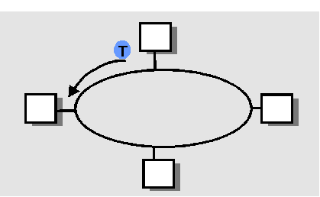
“Taking Turns” MAC protocols
Polling:
master node “invites” slave nodes to transmit in turn
concerns:
  polling overhead
  latency
  single point of failure (master)
Token passing:
control token passed from one node to next sequentially.
token message
concerns:
  token overhead
  latency
  single point of failure (token)
5: DataLink Layer
5-<number>

Slide 37
Summary of MAC protocols
What do you do with a shared media?
  Channel Partitioning, by time, frequency or code
    Time Division, Frequency Division
  Random partitioning (dynamic),
    ALOHA, S-ALOHA, CSMA, CSMA/CD
    carrier sensing: easy in some technologies (wire), hard in others (wireless)
    CSMA/CD used in Ethernet
    CSMA/CA used in 802.11
  Taking Turns
    polling from a central site, token passing
5: DataLink Layer
5-<number>

Slide 38
LAN technologies
Data link layer so far:
  services, error detection/correction, multiple access
Next: LAN technologies
  addressing
  Ethernet
  hubs, switches
  PPP
5: DataLink Layer
5-<number>

Slide 39
Link Layer
Introduction and services
Error detection and correction
Multiple access protocols
Link-Layer Addressing
5: DataLink Layer
5-<number>

Slide 40
MAC Addresses and ARP
32-bit IP address:
  network-layer address
  used to get datagram to destination IP subnet
MAC (or LAN or physical or Ethernet) address:
  used to get frame from one interface to another physically-connected interface (same network)
  48 bit MAC address (for most LANs)
  burned in the adapter ROM
5: DataLink Layer
5-<number>

Slide 41
LAN Addresses and ARP
Each adapter on LAN has unique LAN address
1A-2F-BB-76-09-AD
Broadcast address =
FF-FF-FF-FF-FF-FF
LAN
(wired or
wireless)
= adapter
71-65-F7-2B-08-53
58-23-D7-FA-20-B0
0C-C4-11-6F-E3-98
5: DataLink Layer
5-<number>

Slide 42
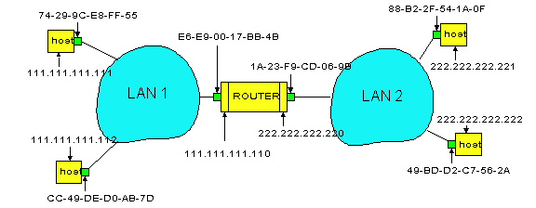
Routing to another LAN
walkthrough: send datagram from A to B via R
assume A know’s B IP address
Two ARP tables in router R, one for each IP network (LAN)
In routing table at source Host, find router 111.111.111.110
In ARP table at source, find MAC address E6-E9-00-17-BB-4B, etc
A
R
B
5: DataLink Layer
5-<number>

Slide 43
A creates datagram with source A, destination B
A uses ARP to get R’s MAC address for 111.111.111.110
A creates link-layer frame with R's MAC address as dest, frame contains A-to-B IP datagram
A’s adapter sends frame
R’s adapter receives frame
R removes IP datagram from Ethernet frame, sees its destined to B
R uses ARP to get B’s MAC address
R creates frame containing A-to-B IP datagram sends to B
A
R
B
5: DataLink Layer
5-<number>

